Slide 1
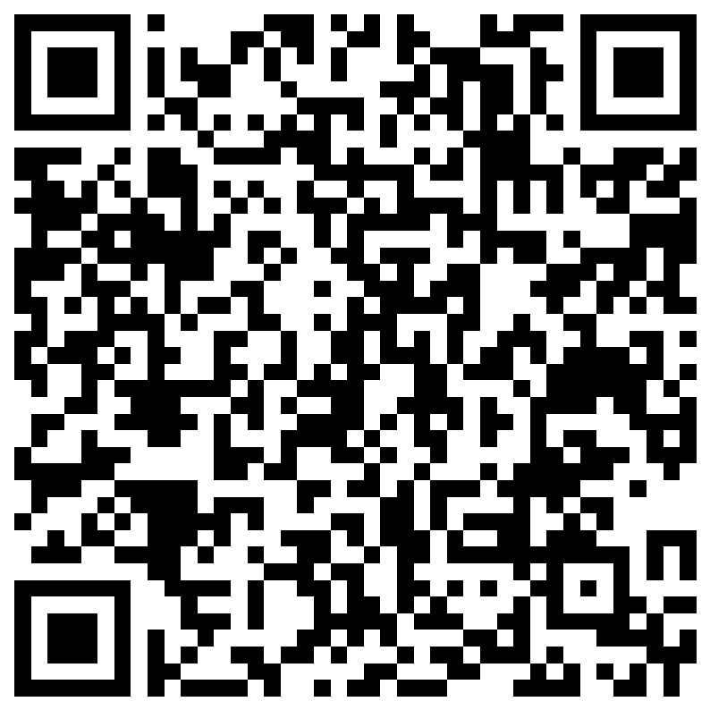
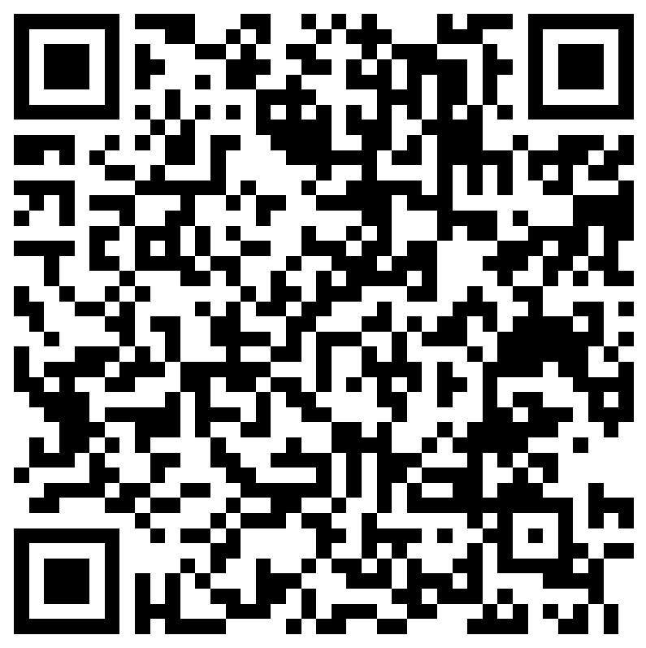
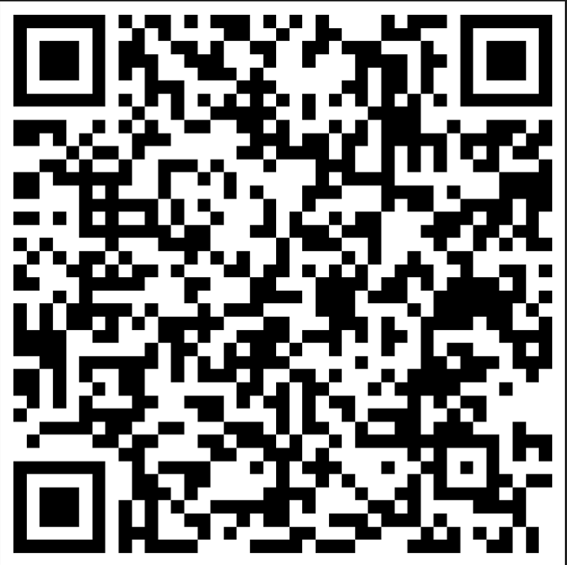
This week we look at Psychological Staff Support Team
Wellbeing Wednesday January 2023
Who are the Psychological Staff Support Team?
The team, which currently consists of one Psychologist and two Assistant Psychologists supported by a dedicated Administrator trained in Mental Health First Aid, provide confidential workplace support for MTW staff experiencing distress impacting on their emotional and psychological health.
What do the team do?
Individual consultations at Pembury, Maidstone and virtually are available to assess the nature of your difficulties and understand if information, psychoeducation, guided self-help or goal-focussed interventions could be of immediate benefit from the team. Where appropriate a brief episode of therapeutic support may be available to enhance your coping and prevent your emotional distress becoming more overwhelming.
If specialist or crisis support is indicated within the community or mental health services the team can help facilitate referrals should you need out of hours or multidisciplinary input.
Other services provided by our team include:
Incident Defuse and Debriefs
Mental Health First Aid Supervision
Departmental Drop ins/Mindfulness Sessions
Wellbeing Awareness Training
Consultation for Managers
Team based Reflective In-reach
How do I get an appointment with the team?
The team now has referral forms that can be quickly accessed and completed 24/7 so that staff can refer themselves, someone else (with consent) or a team. Scan the QR code below or click the link to complete the relevant form.
 | Refer yourself | Refer someone else | Refer a team
Link | https://forms.office.com/r/vmMU2CmmHc | https://forms.office.com/r/Ps9jyHWZnL | https://forms.office.com/r/Abs1SnBKi7
QR Code
Recent Feedback from MTW staff members who have accessed the team
I found the assistant psychologist, very approachable and friendly from the beginning. This instantly put me at ease & I found it very easy to talk to them about anything on my mind. They were both a good listener & proactive in directing me to the most effective help/treatment. We talked about setting goals & taking things a step at a time so that it all feels more manageable, as I am easily overwhelmed. I would highly recommend this service.
I was so impressed with the offer of support and it is at a time when I desperately need it. Without doubt it helped me find tools to stay mentally well, and some suggestions how to manage my working day to improve my mental health. I was also referred on to other services, which I am now using. I was accommodated near to my work base. No improvements from me.
Excellent, I felt listened too, made me feel comfortable to share my problems
Contact details for the team
Call - 01892 633608
Email – mtw-tr.psychologicaloh@nhs.net
Notes:
Template

